Slide 1


Slide 1
Northeast
Member Segmentation
Analysis
Created By: Byron (Pi-Jen) Tang

Slide 2

Slide 7
Background
Objectives
Approach
Data Preprocessing
Data Understanding
Problem Definition
Methodology & Analysis Result
Revenue
Cost
Segmentation
Recommendations
Appendix
Agenda

Slide 3
Slide 10
Background
Roadside assistance is a costly benefit, particularly towing. Members who frequently use roadside assistance are less desirable.
AAA also offers other paid services at highly competitive prices. They also offer insurance, travel and banking/loan products. AAA would like to increase the penetration of these services.
AAA Northeast is one of the regional clubs comprising the American Automobile Association, covering Rhode Island, Connecticut, Massachusetts and portions of New York and New Jersey. AAA Northeast offer services such as roadside assistance, maps, and various discounts as part of their services.

Slide 4
Slide 10
Objectives
Better anticipate the needs of members
Customize communications and offering to various segments
Expend more effort driving acquisition and renewal of desirable members
Provide a market segmentation of AAA members at household level for AAA Northeast to better serve their members. This analysis would allow AAA to:

Slide 5
Slide 10
Approach
Data Preprocessing
Data Understanding
Problem Definition

Slide 6
Slide 4
Data Preprocessing
Data Cleaning:
Remove cancelled members
Transform Income/Credit Ranges/Number of Children to numeric data
Feature Engineering:
Aggregate cost by year to create new cost variables – cost in 2014, cost in 2015, and so on
Count number of member type by HH
Granularity – Household Level:
Use sum or mean of numeric data
Use mode for non-numeric data on variables that are consistent within HH
Fill in missing value with median

Slide 7
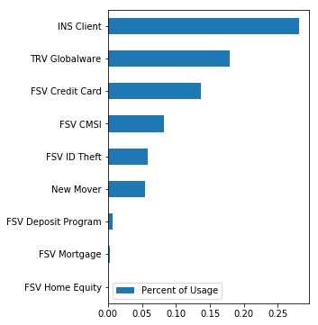
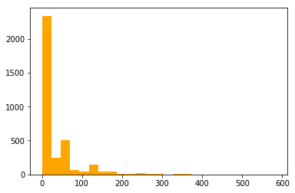
Slide 4
Data Understanding
Revenue
Cost
Segmentation
No. of Product Purchased | No. of Household
0 | 1589
1 | 1220
2 | 539
3 | 135
4 | 25
5 | 3
In general, AAA products have low market penetration. The highest penetration is less than 30% of the household.
The distribution of cost is highly skewed, with 67% households didn't generate any costs in 2019.
Around 45% of the households do not use any products from AAA Northeast, showing big market opportunities

Slide 8
Slide 4
Problem Definition
Predict Probability of Purchasing a Product
Forecast Cost in the Next 12 Months
Explore Market Opportunities
Goal: Find the best models that give the most precise probability of purchasing
Challenge: Unbalanced data
Solution: Up-Sampling
Process & Model (For Each Product):
Up-Sampling
Cross Validation
Decision Tree Model Optimization
Bagging + Optimized Decision Tree
Goal: Find the best models that give the most precise probability of generating cost
Challenge: With skewed distribution, cost prediction has low performance (RMSE)
Solution: Modify question and predict whether a customer will generate cost
Process & Model:
Cross Validation
Decision Tree Model Optimization
Bagging + Optimized Decision Tree
Goal: Explore clusters that would give actionable HH segmentations and enable product strategy
Process & Model:
Gather data used for segmentation:
Probability of purchasing each product
Probability of generating cost in the next 12 months
Apply K-Means Clustering

Slide 9
Slide 10
Analysis Result
Revenue
Cost
Segmentation

Slide 10
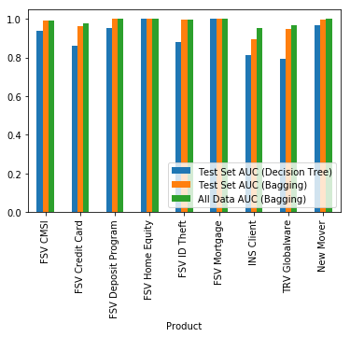
Slide 4
Revenue
Predict Probability of Purchasing a Product
Result – Average AUC:
Test Set (Decision Tree) 0.911474
Test Set (Bagging): 0.975726
All Data (Bagging): 0.986834
With high AUC on predicting all products, we can be confident that the probability of purchasing would be a good reference on potential buyers for each product.

Slide 11
Slide 4
Cost
Forecast Cost in the Next 12 Months
Time-Relevant Variables: Use the cost before year 2019 as year n-1, n-2, and so on to predict the cost in year 2019. Afterwards, treat year 2019 as year n-1, year 2018 as year n-2, and so on to predict the cost in year 2020.
Assumption: The household info would remain the same in year 2020
Result: The best model, bagging + decision tree, returns fair result to get probability of generating cost.
 | Accuracy | AUC
Test Set | 0.77 | 0.77
Whole Data Set | 0.76 | 0.80

Slide 12
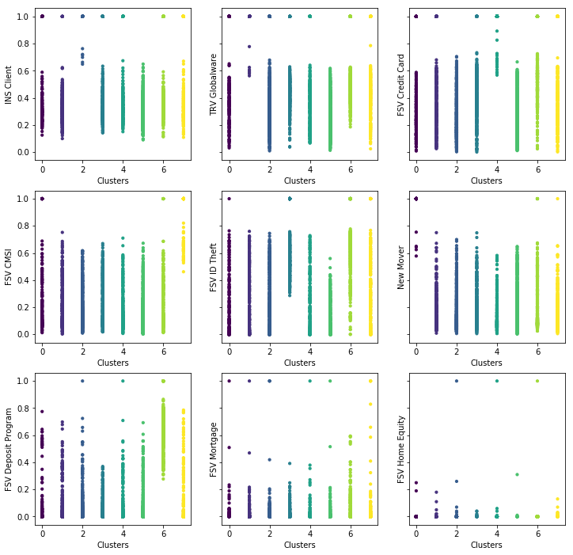
Slide 4
Segmentation – Number of Segments
Explore Market Opportunities
When the households are clustered into 8 or 9 groups, we can identify target groups with high interest on a particular product for 7 products.
Therefore, it seems 8 is an ideal number of clusters.

Slide 13
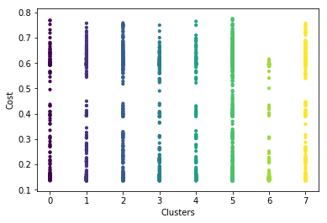
Slide 4
Segmentation – Cost across Segments
Explore Market Opportunities
Predicted probability of cost does not have noticeable difference across clusters. One reason might be that cost is generated randomly as customers only need road service in emergency. It is also possibly because cost is hard to predict.

Slide 14
Slide 10
The table summarizes the size of potential HH for each product.
Each segment represents a target group that is much more likely to purchase the product than the others.
Recommendations
Product | Targeted Household Size* | Avg Prob. of Purchase (Target HHs) | Avg Prob. of Purchase (Non Target HHs)
INS Client | 6 | 0.701071 | 0.419056
FSV Credit Card | 19 | 0.672262 | 0.352905
TRV Globalware | 7 | 0.619258 | 0.391825
FSV CMSI | 48 | 0.638845 | 0.185443
FSV ID Theft | 281 | 0.544852 | 0.218673
New Mover | 6 | 0.707800 | 0.172453
FSV Deposit Program | 361 | 0.616487 | 0.055583
Use the segmentation result to target HHs by product and make tailored product strategies. (See table)
Focus customized product strategy on top 7 popular products
Collect more information for cost prediction or conduct more exploration analysis on the pattern of cost.
* The households that have purchase the product are excluded.

Slide 15
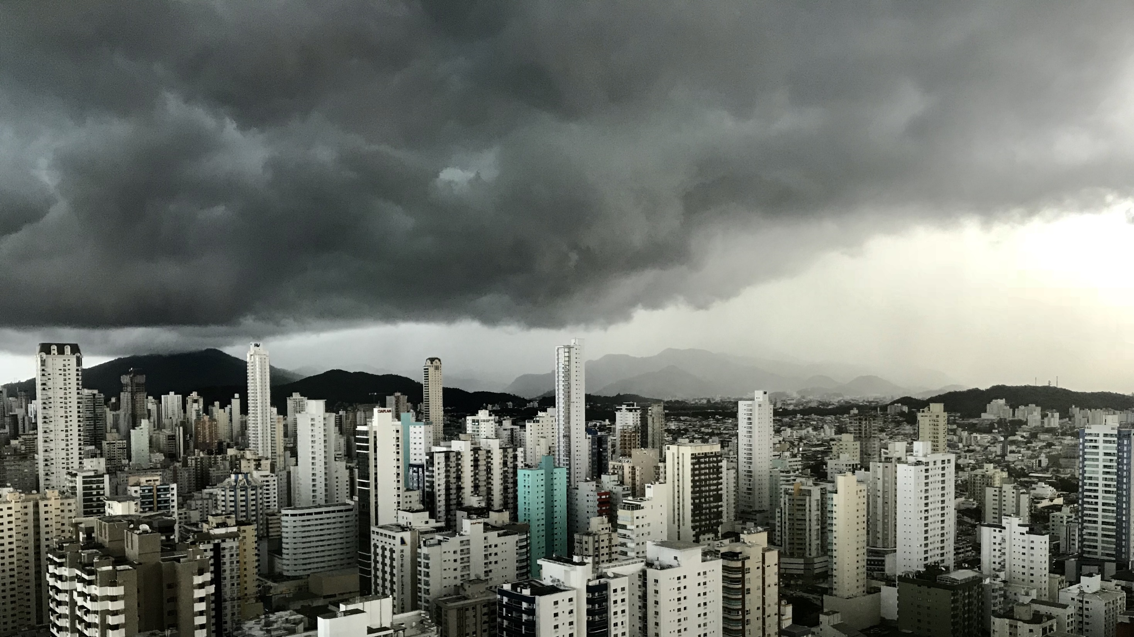
Slide 11
THANK YOU

Slide 16



Slide 12
Appendix
Performance of other models tried for product prediction, using 'INS Client' as an example.
kNN
Logistic Regression
Random Forest

